Slide 1

HOME AUTOMATION BY MATLAB WITH ARDUINO INTERFACE

Slide 2
INTRODUCTION:
We all are familiar with the word ‘Automation’, where the human interaction is minimal and things can be controlled automatically or remotely.
The home automation systems are used for controlling the indoor& outdoor lights, heat, ventilation, air conditioning in the house, to lock or open the doors & gates, to control electrical & electronic appliances and so on using various control systems
in this project, we are going to build home automation using MATLAB and Arduino, which is GUI Based Home Automation System Using Arduino and MATLAB

Slide 3
COMPONENTS:
Arduino UNO
Matlab
relay

Slide 4
ARDUINO:
Arduino is an open-source electronics platform based on easy-to-use hardware and software
Arduino boards are able to read inputs - light on a sensor, a finger on a button, or a Twitter message
and turn it into an output - activating a motor, turning on an LED, publishing something online

Slide 5
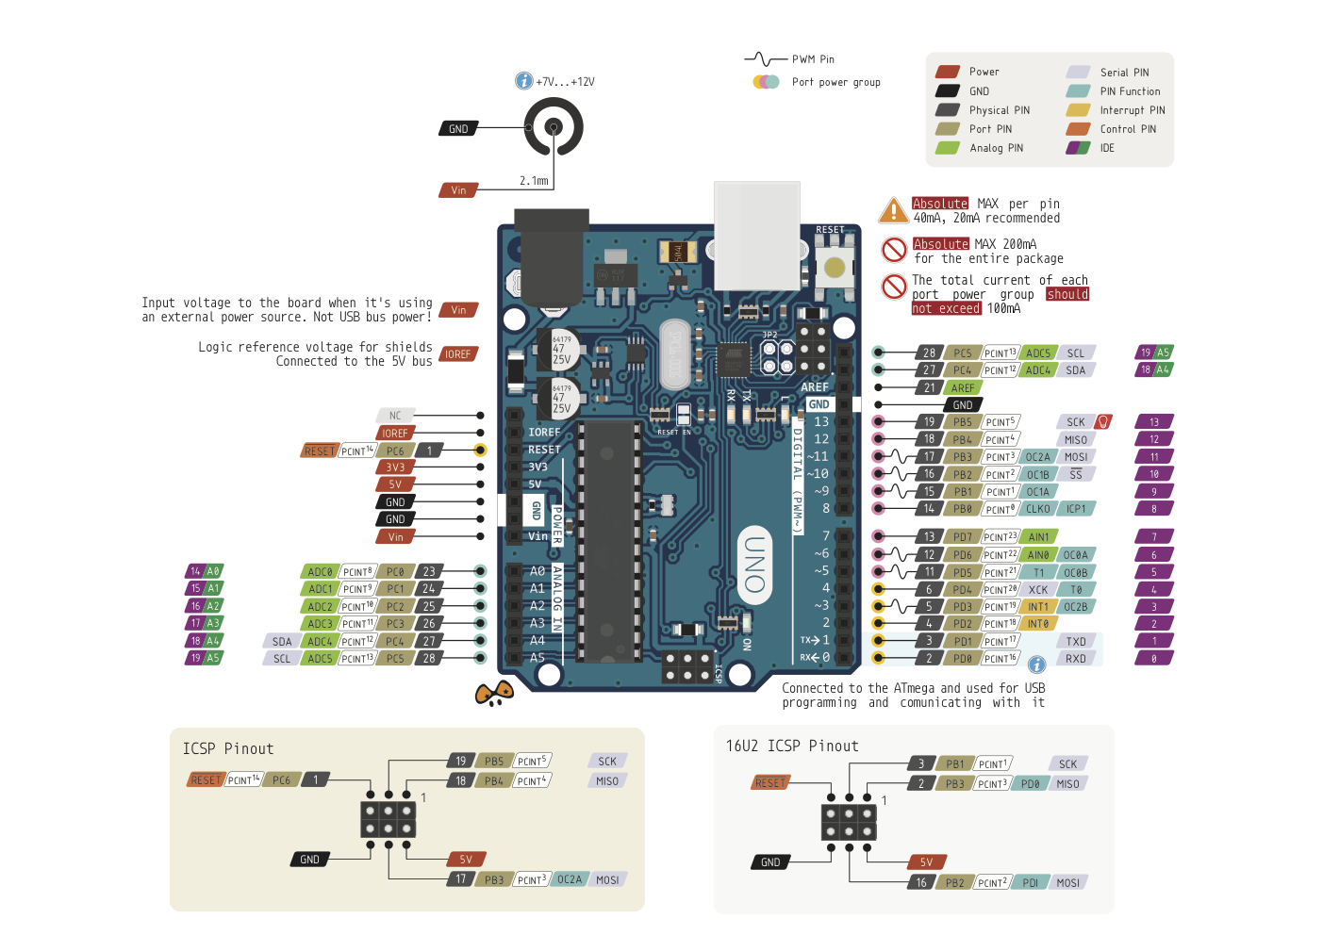
PIN OUT OF ARDUINO:

Slide 6
ADVANTAGES OF ARDUINO:
Inexpensive
Simple, clear programming environment
Open source and extensible software

Slide 7
MATLAB:
MATLAB is a high-performance language for technical computing.
It integrates computation, visualization, and programming in an easy-to-use environment where problems and solutions are expressed in familiar mathematical notation.
Used in application development, including Graphical User Interface building

Slide 8
RELAY:
Relay, specialized electrical switch by means of which a high power device can be controlled by a device of much lower power.
It consists of an electromagnetic coil and mechanical switch contacts that are pushed and pulled by the electromagnet.
The electromagnet requires a current of only a few hundred mille Amps, produced by only a few volts, whereas the contacts may be subjected to hundreds of volts and tens of amps may pass through them.
The switch therefore enables a small electrical current and voltage to control a much larger current and voltage.

Slide 9
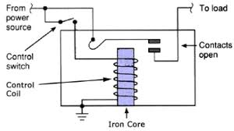
RELAY CIRCUIT DIAGRAM:

Slide 10
MATLAB INTERFACING WITH ARDUINO:
Download the Arduino IO
Then upload the adioe.pde file to the Arduino using Arduino IDE. This adioe.pde file can be found in arduino IO ArduinoIO\pde\adioe\adioe.pde
Then open the MATLAB software, go through the Arduino IO folder, open the install_arduino.m file and Run it in Matlab.
Then we can see a message of “Arduino folders added to the path” in command window of MATLAB, means MATLAB path is updated to Arduino folders.

Slide 11
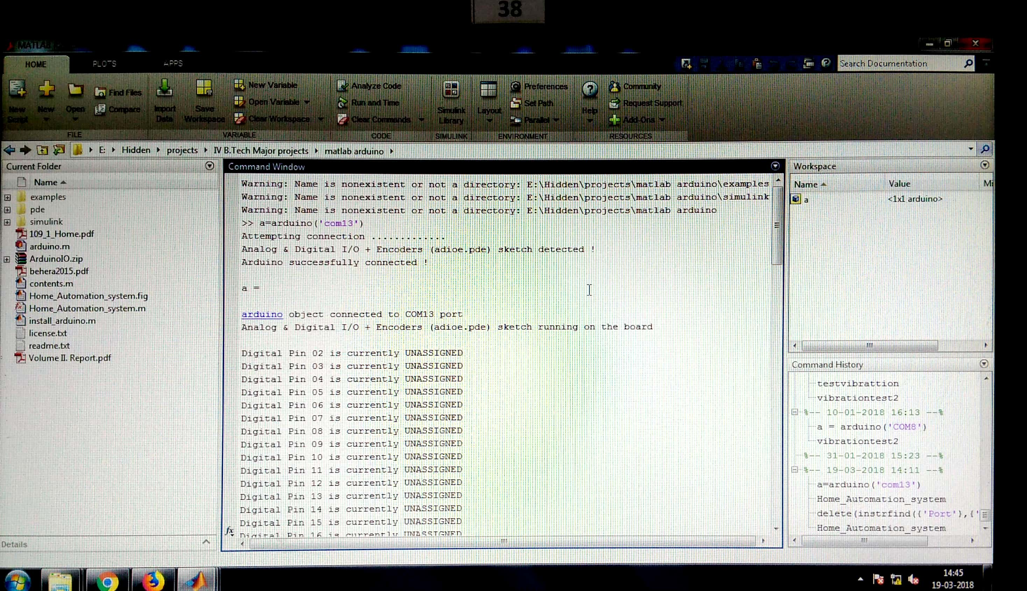
Arduino connected to com13 port:

Slide 12
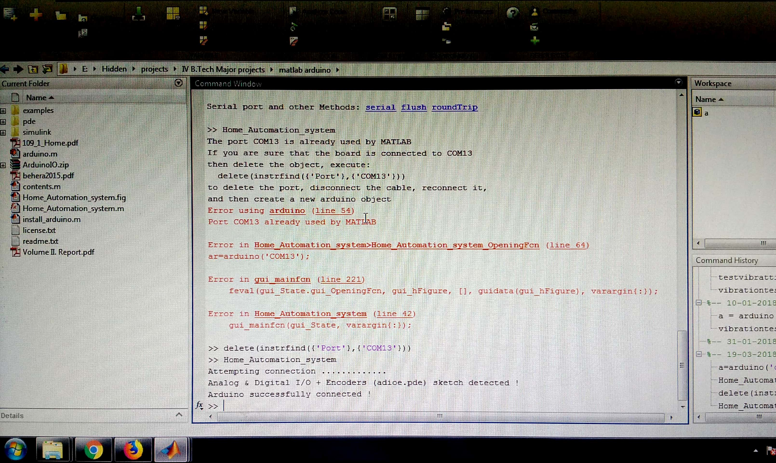
Arduino connected to MATLAB:

Slide 13
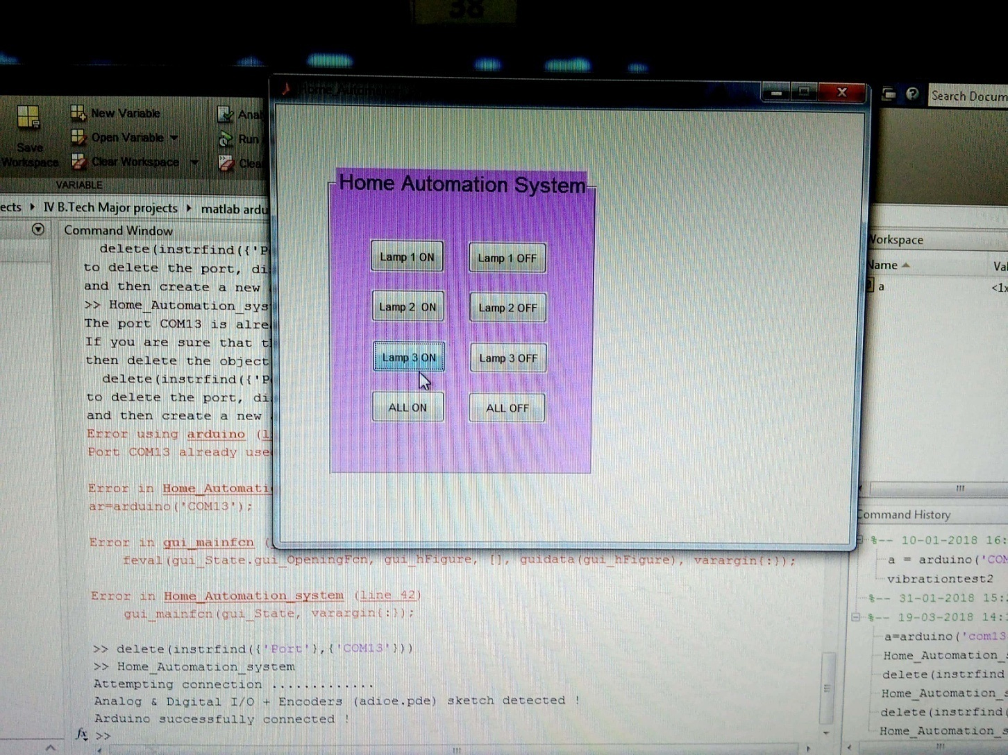
CREATING GUI (graphical user interface):
Basically in GUI, we are creating Push Buttons for controlling the home appliances from computer.
Buttons can be created by going into “Graphical User Interface” in “New” menu in MATLAB.
Further we can set the name and colours of these buttons, we have created 8 buttons
in which six to ON and OFF three home appliances and two buttons to ON and OFF all the appliances simultaneously.
GUI WINDOW:

Slide 14
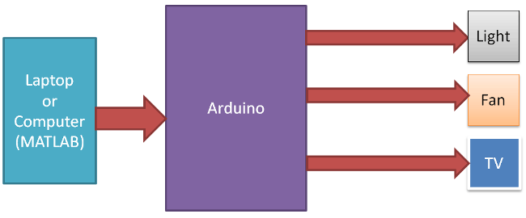
BLOCK DIAGRAM:

Slide 15
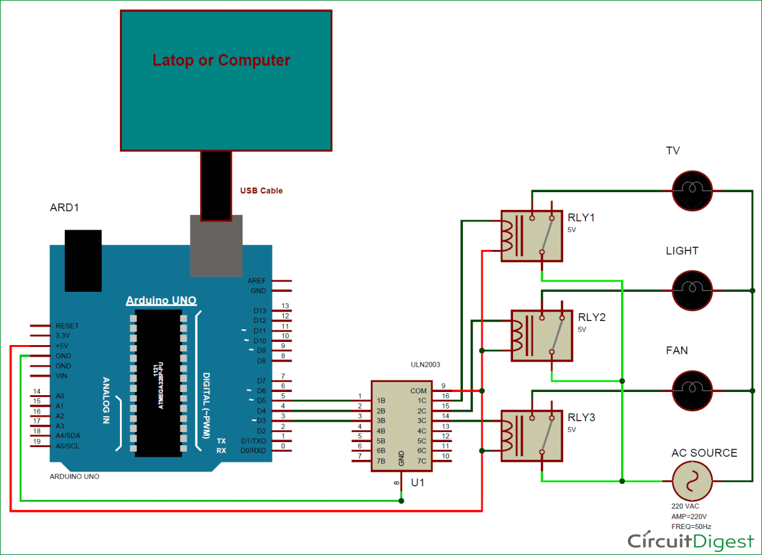
CIRCUIT DIAGRAM:

Slide 16
WORKING:
Here we have used an Arduino UNO board and Relay Driver ULN2003 for driving relays.
Three 5 volt SPDT Relays are connected to Arduino pin number 3, 4 and 5, through relay driver ULN2003, for controlling LIGHT, FAN and TV respectively
After interfacing matlab with arduino by clicking push buttons in GUI we can control the home appliances

Slide 17
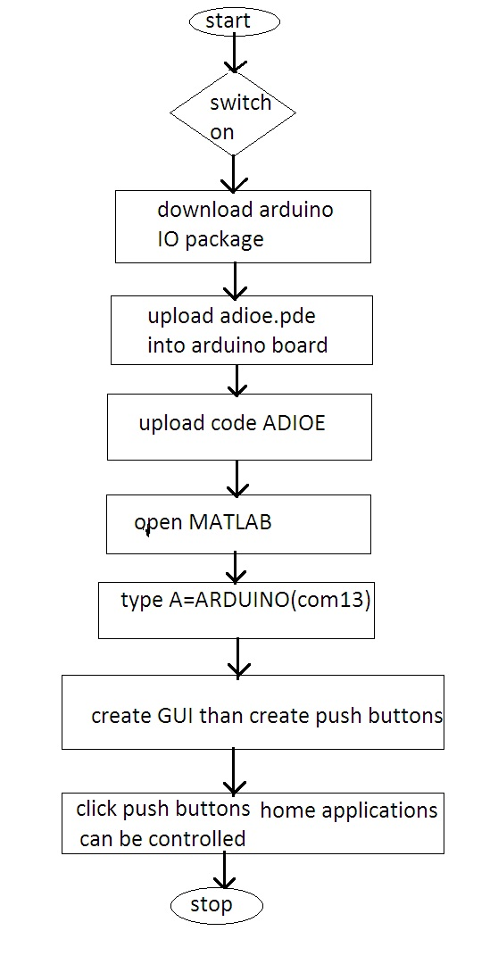
Flow chart

Slide 18
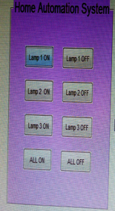
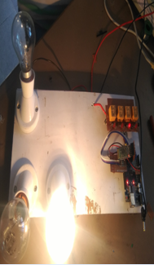
RESULTS:

Slide 19
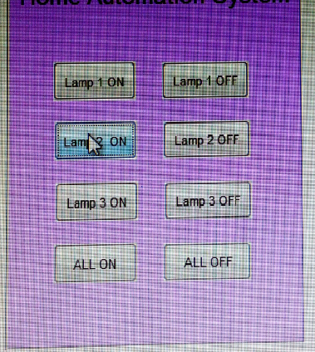
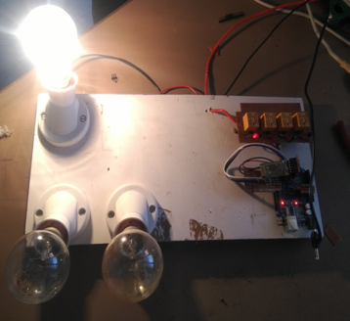
WHEN LAMP-2 IS ON:

Slide 20
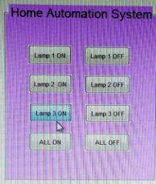
WHEN LAMP-3 IS ON:

Slide 21
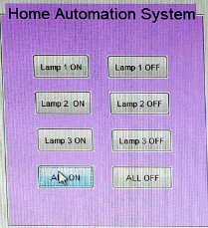
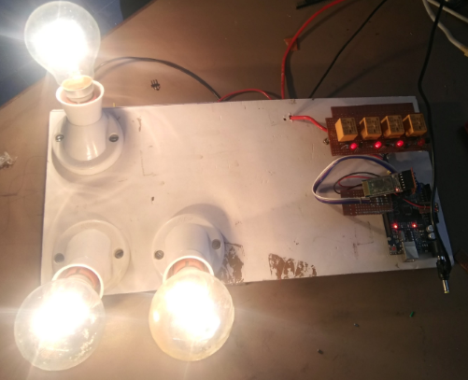
WHEN 3-LAMPS ARE ON POSITION:

Slide 22
Advantages:
By interfacing Arduino with MATLAB, we can acquire Sensor Data from Arduino and start plotting various graphs.
We can create GUI (Graphical User Interface) for controlling our Arduino with the help of MATLAB.
A wide range of projects related to image processing and signal processing can be implemented using Arduino and MATLAB.
Some of the projects can be Color Detection, Object Tracking, Face Detection, etc.

Slide 23
CONCLUSION
In this project we presented a system which is developed with MATLAB-Arduino interface to control simple home appliances.
The GUI designed in MATLAB allow user to turn ON and OFF interfaced devices and shows current status of these devices in edit box.
Thus system presented in this project is useful to understand basic hardware interfacing and controlling with MATLAB-Arduino interface.

